Slide 1
Information Retrieval and Map-Reduce Implementations
Adopted from Jimmy Lin’s slides, which is licensed under a Creative Commons Attribution-Noncommercial-Share Alike 3.0 United States

Slide 2
Roadmap
Introduction to information retrieval
Basics of indexing and retrieval
Inverted indexing in MapReduce
Retrieval at scale

Slide 3
First, nomenclature…
Information retrieval (IR)
  Focus on textual information (= text/document retrieval)
  Other possibilities include image, video, music, …
What do we search?
  Generically, “collections”
  Less-frequently used, “corpora”
What do we find?
  Generically, “documents”
  Even though we may be referring to web pages, PDFs, PowerPoint slides, paragraphs, etc.

Slide 4
Information Retrieval Cycle
Source
Selection
Resource
Query
Formulation
Query
Search
Results
Selection
Documents
System discovery
Vocabulary discovery
Concept discovery
Document discovery
Examination
Information
source reselection
Delivery

Slide 5


The Central Problem in Search
Author
Searcher
Concepts
Concepts
Query Terms
Document Terms
“tragic love story”
“fateful star-crossed romance”
Do these represent the same concepts?
Notes:
Why is IR hard? Because language is hard!

Slide 6
Abstract IR Architecture
Documents
Query
document acquisition
(e.g., web crawling)
online
offline
Representation
Function
Representation
Function
Query Representation
Document Representation
Index
Comparison
Function
Hits

Slide 7
How do we represent text?
Remember: computers don’t “understand” anything!
“Bag of words”
  Treat all the words in a document as index terms
  Assign a “weight” to each term based on “importance”
  (or, in simplest case, presence/absence of word)
  Disregard order, structure, meaning, etc. of the words
  Simple, yet effective!
Assumptions
  Term occurrence is independent
  Document relevance is independent
  “Words” are well-defined

Slide 8
What’s a word?
天主教教宗若望保祿二世因感冒再度住進醫院。這是他今年第二度因同樣的病因住院。
وقال مارك ريجيف - الناطق باسم
الخارجية الإسرائيلية - إن شارون قبل
الدعوة وسيقوم للمرة الأولى بزيارة
تونس، التي كانت لفترة طويلة المقر
الرسمي لمنظمة التحرير الفلسطينية بعد خروجها من لبنان عام 1982.
Выступая в Мещанском суде Москвы экс-глава ЮКОСа заявил не совершал ничего противозаконного, в чем обвиняет его генпрокуратура России.
भारत सरकार ने आर्थिक सर्वेक्षण में वित्तीय वर्ष 2005-06 में सात फ़ीसदी विकास दर हासिल करने का आकलन किया है और कर सुधार पर ज़ोर दिया है
日米連合で台頭中国に対処…アーミテージ前副長官提言
조재영 기자= 서울시는 25일 이명박 시장이 `행정중심복합도시'' 건설안에 대해 `군대라도 동원해 막고싶은 심정''이라고 말했다는 일부 언론의 보도를 부인했다.

Slide 9
Sample Document
McDonald's slims down spuds
Fast-food chain to reduce certain types of fat in its french fries with new cooking oil.
NEW YORK (CNN/Money) - McDonald's Corp. is cutting the amount of "bad" fat in its french fries nearly in half, the fast-food chain said Tuesday as it moves to make all its fried menu items healthier.
But does that mean the popular shoestring fries won't taste the same? The company says no. "It's a win-win for our customers because they are getting the same great french-fry taste along with an even healthier nutrition profile," said Mike Roberts, president of McDonald's USA.
But others are not so sure. McDonald's will not specifically discuss the kind of oil it plans to use, but at least one nutrition expert says playing with the formula could mean a different taste.
Shares of Oak Brook, Ill.-based McDonald's (MCD: down $0.54 to $23.22, Research, Estimates) were lower Tuesday afternoon. It was unclear Tuesday whether competitors Burger King and Wendy's International (WEN: down $0.80 to $34.91, Research, Estimates) would follow suit. Neither company could immediately be reached for comment.
…
“Bag of Words”
14 × McDonalds
12 × fat
11 × fries
8 × new
7 × french
6 × company, said, nutrition
5 × food, oil, percent, reduce, taste, Tuesday
…

Slide 10
Information retrieval models
An IR model governs how a document and a query are represented and how the relevance of a document to a user query is defined.
Main models:
  Boolean model
  Vector space model
  Statistical language model
  etc

Slide 11
Boolean model
Each document or query is treated as a “bag” of words or terms. Word sequence is not considered.
Given a collection of documents D, let V = {t₁, t₂, ..., t_{|V|}} be the set of distinctive words/terms in the collection. V is called the vocabulary.
A weight w_{ij} > 0 is associated with each term t_{i} of a document d_{j} ∈ D. For a term that does not appear in document d_{j}, w_{ij} = 0.
d_{j} = (w_{1j}, w_{2j}, ..., w_{|V|j}),

Slide 12
Boolean model (contd)
Query terms are combined logically using the Boolean operators AND, OR, and NOT.
  E.g., ((data AND mining) AND (NOT text))
Retrieval
  Given a Boolean query, the system retrieves every document that makes the query logically true.
  Called exact match.
The retrieval results are usually quite poor because term frequency is not considered.

Slide 13
Boolean queries: Exact match
Sec. 1.3
The Boolean retrieval model is being able to ask a query that is a Boolean expression:
  Boolean Queries are queries using AND, OR and NOT to join query terms
    Views each document as a set of words
    Is precise: document matches condition or not.
  Perhaps the simplest model to build an IR system on
Primary commercial retrieval tool for 3 decades.
Many search systems you still use are Boolean:
  Email, library catalog, Mac OS X Spotlight

Slide 14
Strengths and Weaknesses
Strengths
  Precise, if you know the right strategies
  Precise, if you have an idea of what you’re looking for
  Implementations are fast and efficient
Weaknesses
  Users must learn Boolean logic
  Boolean logic insufficient to capture the richness of language
  No control over size of result set: either too many hits or none
  When do you stop reading? All documents in the result set are considered “equally good”
  What about partial matches? Documents that “don’t quite match” the query may be useful also

Slide 15
Vector Space Model
t₃
d₂
d₃
d₁
θ
φ
t₁
d₅
t₂
d₄
Assumption: Documents that are “close together” in vector space “talk about” the same things
Therefore, retrieve documents based on how close the document is to the query (i.e., similarity ~ “closeness”)

Slide 16
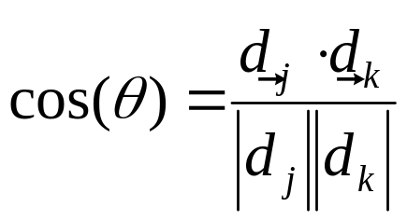
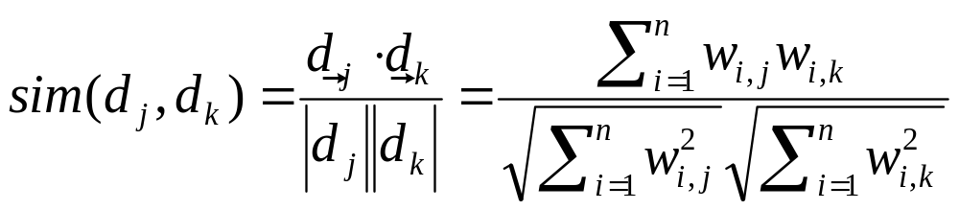
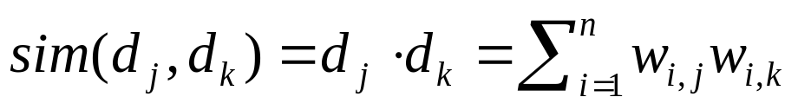
Similarity Metric
Use “angle” between the vectors:
Or, more generally, inner products:

Slide 17
Vector space model
Documents are also treated as a “bag” of words or terms.
Each document is represented as a vector.
However, the term weights are no longer 0 or 1. Each term weight is computed based on some variations of TF or TF-IDF scheme.

Slide 18
Term Weighting
Term weights consist of two components
  Local: how important is the term in this document?
  Global: how important is the term in the collection?
Here’s the intuition:
  Terms that appear often in a document should get high weights
  Terms that appear in many documents should get low weights
How do we capture this mathematically?
  Term frequency (local)
  Inverse document frequency (global)

Slide 19
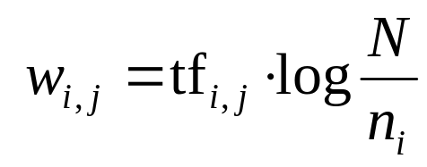
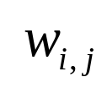
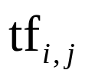



TF.IDF Term Weighting
weight assigned to term i in document j
number of occurrence of term i in document j
number of documents in entire collection
number of documents with term i

Slide 20

Retrieval in vector space model
Query q is represented in the same way or slightly differently.
Relevance of d_{i} to q: Compare the similarity of query q and document d_{i}.
Cosine similarity (the cosine of the angle between the two vectors)
Cosine is also commonly used in text clustering

Slide 21
An Example
A document space is defined by three terms:
  hardware, software, users
  the vocabulary
A set of documents are defined as:
  A1=(1, 0, 0), A2=(0, 1, 0), A3=(0, 0, 1)
  A4=(1, 1, 0), A5=(1, 0, 1), A6=(0, 1, 1)
  A7=(1, 1, 1) A8=(1, 0, 1). A9=(0, 1, 1)
If the Query is “hardware and software”
what documents should be retrieved?

Slide 22
An Example (cont.)
In Boolean query matching:
  document A4, A7 will be retrieved (“AND”)
  retrieved: A1, A2, A4, A5, A6, A7, A8, A9 (“OR”)
In similarity matching (cosine):
  q=(1, 1, 0)
  S(q, A1)=0.71, S(q, A2)=0.71, S(q, A3)=0
  S(q, A4)=1, S(q, A5)=0.5, S(q, A6)=0.5
  S(q, A7)=0.82, S(q, A8)=0.5, S(q, A9)=0.5
  Document retrieved set (with ranking)=
    {A4, A7, A1, A2, A5, A6, A8, A9}

Slide 23
Constructing Inverted Index (Word Counting)
Documents
case folding, tokenization, stopword removal, stemming
Bag of Words
syntax, semantics, word knowledge, etc.
Inverted
Index

Slide 24
Stopwords removal
Many of the most frequently used words in English are useless in IR and text mining – these words are called stop words.
  the, of, and, to, ….
  Typically about 400 to 500 such words
  For an application, an additional domain specific stopwords list may be constructed
Why do we need to remove stopwords?
  Reduce indexing (or data) file size
    stopwords accounts 20-30% of total word counts.
  Improve efficiency and effectiveness
    stopwords are not useful for searching or text mining
    they may also confuse the retrieval system.

Slide 25
Stemming
Techniques used to find out the root/stem of a word. E.g.,
      user engineering
      users engineered
      used engineer
      using
stem: use engineer
Usefulness:
improving effectiveness of IR and text mining
  matching similar words
  Mainly improve recall
reducing indexing size
  combing words with same roots may reduce indexing size as much as 40-50%.

Slide 26
Basic stemming methods
Using a set of rules. E.g.,
remove ending
  if a word ends with a consonant other than s,
  followed by an s, then delete s.
  if a word ends in es, drop the s.
  if a word ends in ing, delete the ing unless the remaining word consists only of one letter or of th.
  If a word ends with ed, preceded by a consonant, delete the ed unless this leaves only a single letter.
  …...
transform words
  if a word ends with “ies” but not “eies” or “aies” then “ies --> y.”

Slide 27
Inverted index
The inverted index of a document collection is basically a data structure that
  attaches each distinctive term with a list of all documents that contains the term.
Thus, in retrieval, it takes constant time to
  find the documents that contains a query term.
  multiple query terms are also easy handle as we will see soon.

Slide 28
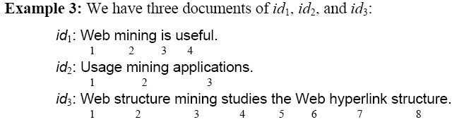
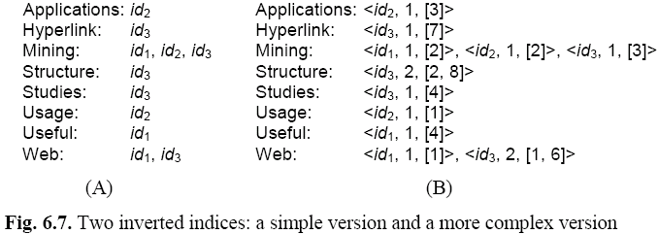
An example

Slide 29
Search using inverted index
Given a query q, search has the following steps:
Step 1 (vocabulary search): find each term/word in q in the inverted index.
Step 2 (results merging): Merge results to find documents that contain all or some of the words/terms in q.
Step 3 (Rank score computation): To rank the resulting documents/pages, using,
  content-based ranking
  link-based ranking

Slide 30
Inverted Index: Boolean Retrieval
Doc 1
Doc 2
Doc 3
Doc 4
one fish, two fish
red fish, blue fish
cat in the hat
green eggs and ham
1
2
3
4
blue
1
blue
2
cat
1
cat
3
egg
1
egg
4
fish
1
1
fish
1
2
green
1
green
4
ham
1
ham
4
hat
1
hat
3
one
1
one
1
red
1
red
2
two
1
two
1

Slide 31
Boolean Retrieval
To execute a Boolean query:
  Build query syntax tree
  For each clause, look up postings
  Traverse postings and apply Boolean operator
Efficiency analysis
  Postings traversal is linear (assuming sorted postings)
  Start with shortest posting first
OR
( blue AND fish ) OR ham
ham
AND
blue
fish
blue
2
fish
1
2

Slide 32
Query processing: AND
Sec. 1.3
Consider processing the query:
  Brutus AND Caesar
  Locate Brutus in the Dictionary;
    Retrieve its postings.
  Locate Caesar in the Dictionary;
    Retrieve its postings.
  “Merge” the two postings:
2
4
8
16
32
64
128
Brutus
1
2
3
5
8
13
21
34
Caesar

Slide 33
The merge
Sec. 1.3
Walk through the two postings simultaneously, in time linear in the total number of postings entries
2
4
4
8
16
16
128
2
8
32
64
128
32
64
Brutus
2
8
1
2
5
8
13
21
34
Caesar
1
2
3
5
8
13
21
34
3
If the list lengths are x and y, the merge takes O(x+y)
operations.
Crucial: postings sorted by docID.

Slide 34

Intersecting two postings lists
(a “merge” algorithm)

Slide 35
Inverted Index: TF.IDF
Doc 1
Doc 2
Doc 3
Doc 4
one fish, two fish
red fish, blue fish
cat in the hat
green eggs and ham
tf
1
2
3
4
df
blue
1
1
blue
1
2
1
cat
1
1
cat
1
3
1
egg
1
1
egg
1
4
1
fish
2
2
2
fish
2
1
2
2
2
green
1
1
green
1
4
1
ham
1
1
ham
1
4
1
hat
1
1
hat
1
3
1
one
1
1
one
1
1
1
red
1
1
red
1
2
1
two
1
1
two
1
1
1

Slide 36
Positional Indexes
Store term position in postings
Supports richer queries (e.g., proximity)
Naturally, leads to larger indexes…

Slide 37
Inverted Index: Positional Information
Doc 1
Doc 2
Doc 3
Doc 4
one fish, two fish
red fish, blue fish
cat in the hat
green eggs and ham
tf
1
2
3
4
df
blue
1
1
blue
1
2
1
[3]
cat
1
1
cat
1
3
1
[1]
egg
1
1
egg
1
4
1
[2]
fish
2
2
2
fish
2
1
2
[2,4]
2
2
[2,4]
green
1
1
green
1
4
1
[1]
ham
1
1
ham
1
4
1
[3]
hat
1
1
hat
1
3
1
[2]
one
1
1
one
1
1
1
[1]
red
1
1
red
1
2
1
[1]
two
1
1
two
1
1
1
[3]

Slide 38
Retrieval in a Nutshell
Look up postings lists corresponding to query terms
Traverse postings for each query term
Store partial query-document scores in accumulators
Select top k results to return

Slide 39
Retrieval: Document-at-a-Time
Evaluate documents one at a time (score all query terms)
Tradeoffs
  Small memory footprint (good)
  Must read through all postings (bad), but skipping possible
  More disk seeks (bad), but blocking possible
blue
9
2
21
1
35
1
…
fish
1
2
9
1
21
3
34
1
35
2
80
3
…
Accumulators
(e.g. priority queue)
Document score in top k?
Yes: Insert document score, extract-min if queue too large
No: Do nothing

Slide 40
Retrieval: Query-At-A-Time
Evaluate documents one query term at a time
  Usually, starting from most rare term (often with tf-sorted postings)
Tradeoffs
  Early termination heuristics (good)
  Large memory footprint (bad), but filtering heuristics possible
blue
9
2
21
1
35
1
…
Accumulators
(e.g., hash)
Score_{{q=x}}(doc n) = s
fish
1
2
9
1
21
3
34
1
35
2
80
3
…

Slide 41
MapReduce it?
The indexing problem
  Scalability is critical
  Must be relatively fast, but need not be real time
  Fundamentally a batch operation
  Incremental updates may or may not be important
  For the web, crawling is a challenge in itself
The retrieval problem
  Must have sub-second response time
  For the web, only need relatively few results
Perfect for MapReduce!
Uh… not so good…

Slide 42
Indexing: Performance Analysis
Fundamentally, a large sorting problem
  Terms usually fit in memory
  Postings usually don’t
How is it done on a single machine?
How can it be done with MapReduce?
First, let’s characterize the problem size:
  Size of vocabulary
  Size of postings

Slide 43
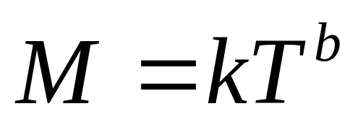
Vocabulary Size: Heaps’ Law
Heaps’ Law: linear in log-log space
Vocabulary size grows unbounded!
M is vocabulary size
T is collection size (number of documents)
k and b are constants
Typically, k is between 30 and 100, b is between 0.4 and 0.6
Notes:
22

Slide 44
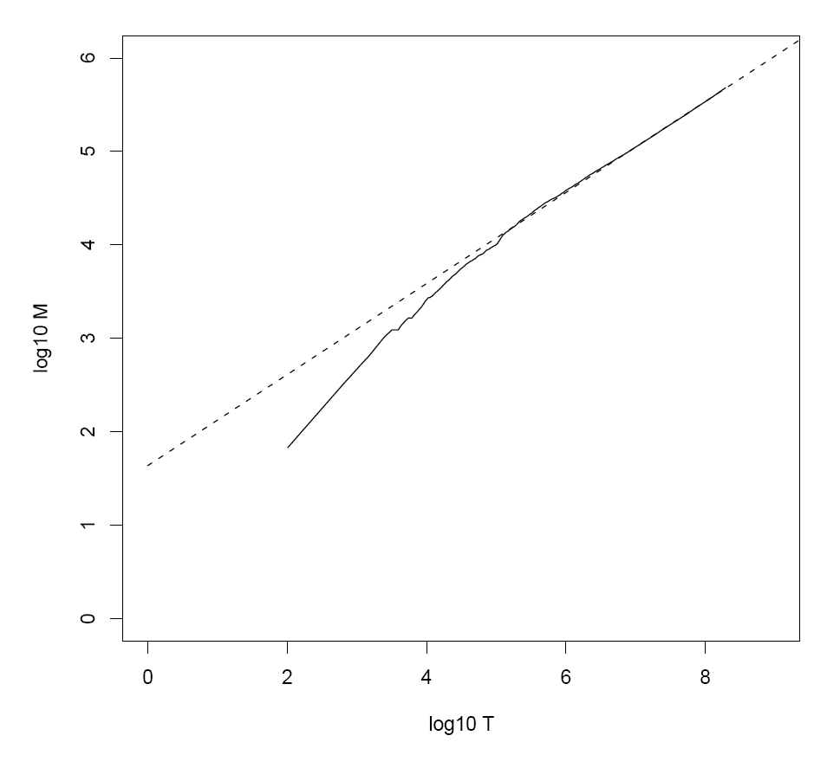
Heaps’ Law for RCV1
k = 44
b = 0.49
First 1,000,020 terms:
Predicted = 38,323
Actual = 38,365
Reuters-RCV1 collection: 806,791 newswire documents (Aug 20, 1996-August 19, 1997)
Manning, Raghavan, Schütze, Introduction to Information Retrieval (2008)

Slide 45
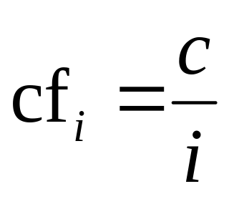
Postings Size: Zipf’s Law
Zipf’s Law: (also) linear in log-log space
  Specific case of Power Law distributions
In other words:
  A few elements occur very frequently
  Many elements occur very infrequently
cf is the collection frequency of i-th common term
c is a constant
Notes:
22

Slide 46
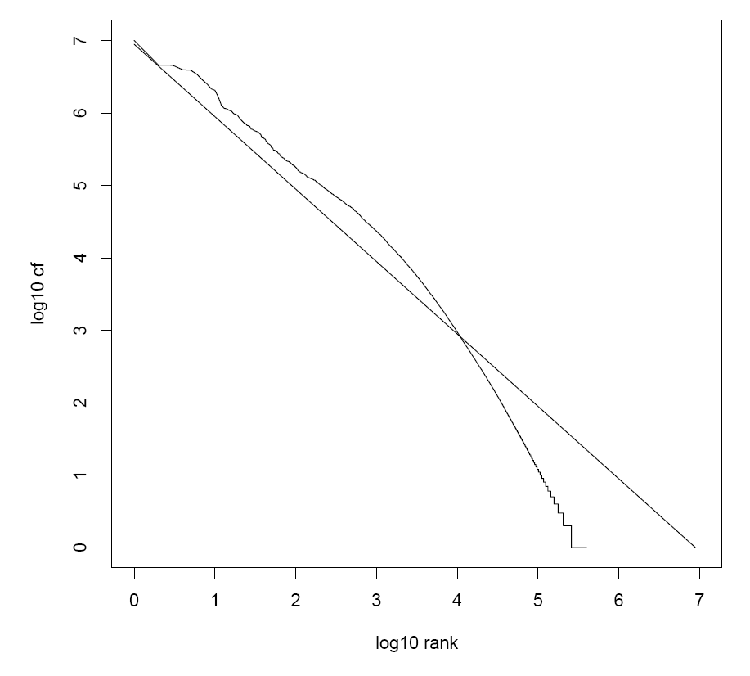
Zipf’s Law for RCV1
Fit isn’t that good… but good enough!
Reuters-RCV1 collection: 806,791 newswire documents (Aug 20, 1996-August 19, 1997)
Manning, Raghavan, Schütze, Introduction to Information Retrieval (2008)

Slide 47
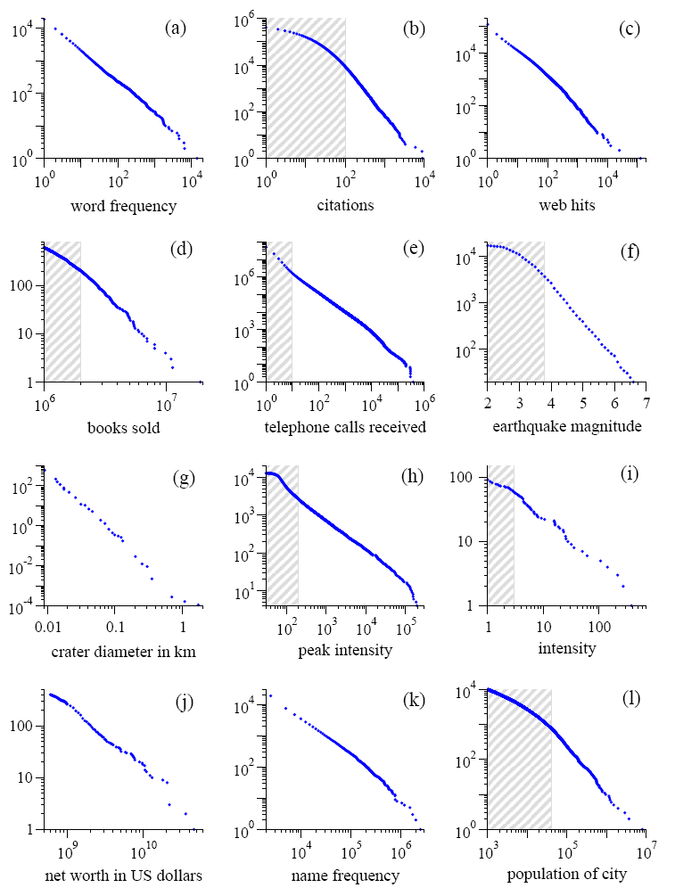
Power Laws are everywhere!
Figure from: Newman, M. E. J. (2005) “Power laws, Pareto distributions and Zipf's law.” Contemporary Physics 46:323–351.

Slide 48
MapReduce: Index Construction
Map over all documents
  Emit term as key, (docno, tf) as value
  Emit other information as necessary (e.g., term position)
Sort/shuffle: group postings by term
Reduce
  Gather and sort the postings (e.g., by docno or tf)
  Write postings to disk
MapReduce does all the heavy lifting!

Slide 49
Inverted Indexing with MapReduce
Doc 1
Doc 2
Doc 3
one fish, two fish
red fish, blue fish
cat in the hat
one
1
1
red
2
1
cat
3
1
Map
two
blue
hat
1
1
2
1
3
1
fish
1
2
fish
2
2
Shuffle and Sort: aggregate values by keys
cat
3
1
Reduce
blue
2
1
fish
1
2
2
2
hat
3
1
one
1
1
two
1
1
red
2
1

Slide 50
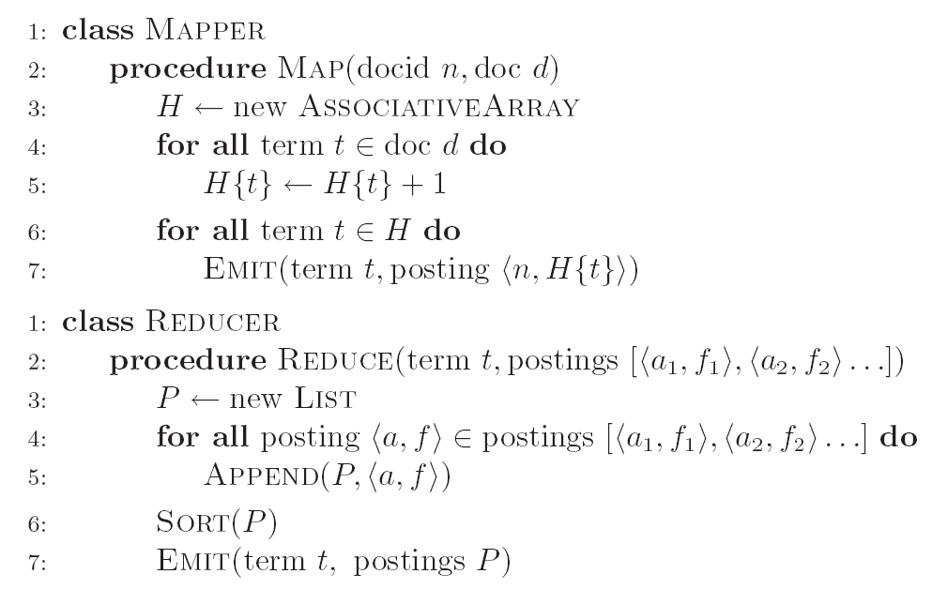
Inverted Indexing: Pseudo-Code

Slide 51
Positional Indexes
Doc 1
Doc 2
Doc 3
one fish, two fish
red fish, blue fish
cat in the hat
one
1
1
[1]
red
2
1
[1]
cat
3
1
[1]
Map
two
blue
hat
1
1
[3]
2
1
[3]
3
1
[2]
fish
1
2
[2,4]
fish
2
2
[2,4]
Shuffle and Sort: aggregate values by keys
cat
3
1
[1]
Reduce
blue
2
1
[3]
fish
1
2
[2,4]
2
2
[2,4]
hat
3
1
[2]
one
1
1
[1]
two
1
1
[3]
red
2
1
[1]

Slide 52
Inverted Indexing: Pseudo-Code
What’s the problem?

Slide 53
Scalability Bottleneck
Initial implementation: terms as keys, postings as values
  Reducers must buffer all postings associated with key (to sort)
  What if we run out of memory to buffer postings?
Uh oh!

Slide 54
Another Try…
(key)
(values)
(keys)
(values)
fish
1
2
[2,4]
fish
1
[2,4]
34
1
[23]
fish
9
[9]
21
3
[1,8,22]
fish
21
[1,8,22]
35
2
[8,41]
fish
34
[23]
80
3
[2,9,76]
fish
35
[8,41]
9
1
[9]
fish
80
[2,9,76]
How is this different?
Let the framework do the sorting
Term frequency implicitly stored
Directly write postings to disk!
Where have we seen this before?

Slide 55
Postings Encoding
Conceptually:
fish
1
2
9
1
21
3
34
1
35
2
80
3
…
In Practice:
Don’t encode docnos, encode gaps (or d-gaps)
But it’s not obvious that this save space…
fish
1
2
8
1
12
3
13
1
1
2
45
3
…

Slide 56
Overview of Index Compression
Byte-aligned vs. bit-aligned
  VarInt
  Group VarInt
  Simple-9
Non-parameterized bit-aligned
  Unary codes
  γ codes
  δ codes
Parameterized bit-aligned
  Golomb codes (local Bernoulli model)
Want more detail? Read Managing Gigabytes by Witten, Moffat, and Bell!

Slide 57
Index Compression: Performance
Comparison of Index Size (bits per pointer)
Bible | TREC
Unary | 262 | 1918
Binary | 15 | 20
γ | 6.51 | 6.63
δ | 6.23 | 6.38
Golomb | 6.09 | 5.84
Recommend best practice
Bible: King James version of the Bible; 31,101 verses (4.3 MB)
TREC: TREC disks 1+2; 741,856 docs (2070 MB)
Witten, Moffat, Bell, Managing Gigabytes (1999)

Slide 58
Getting the df
In the mapper:
  Emit “special” key-value pairs to keep track of df
In the reducer:
  Make sure “special” key-value pairs come first: process them to determine df
Remember: proper partitioning!

Slide 59
Getting the df: Modified Mapper
Doc 1
Input document…
one fish, two fish
(key)
(value)
fish
1
[2,4]
Emit normal key-value pairs…
one
1
[1]
two
1
[3]
fish
★
[1]
Emit “special” key-value pairs to keep track of df…
one
★
[1]
two
★
[1]

Slide 60
Getting the df: Modified Reducer
(key)
(value)
fish
★
[63]
[82]
[27]
…
First, compute the df by summing contributions from all “special” key-value pair…
Compute Golomb parameter b…
fish
1
[2,4]
fish
9
[9]
fish
21
[1,8,22]
Important: properly define sort order to make sure “special” key-value pairs come first!
fish
34
[23]
fish
35
[8,41]
fish
80
[2,9,76]
…
Write postings directly to disk
Where have we seen this before?

Slide 61
MapReduce it?
The indexing problem
  Scalability is paramount
  Must be relatively fast, but need not be real time
  Fundamentally a batch operation
  Incremental updates may or may not be important
  For the web, crawling is a challenge in itself
The retrieval problem
  Must have sub-second response time
  For the web, only need relatively few results
Just covered
Now

Slide 62
Retrieval with MapReduce?
MapReduce is fundamentally batch-oriented
  Optimized for throughput, not latency
  Startup of mappers and reducers is expensive
MapReduce is not suitable for real-time queries!
  Use separate infrastructure for retrieval…

Slide 63
Important Ideas
Partitioning (for scalability)
Replication (for redundancy)
Caching (for speed)
Routing (for load balancing)
The rest is just details!

Slide 64
Term vs. Document Partitioning
D
T₁
D
T₂
Term
Partitioning
…
T₃
T
Document
Partitioning
…
T
D₁
D₂
D₃

Slide 65
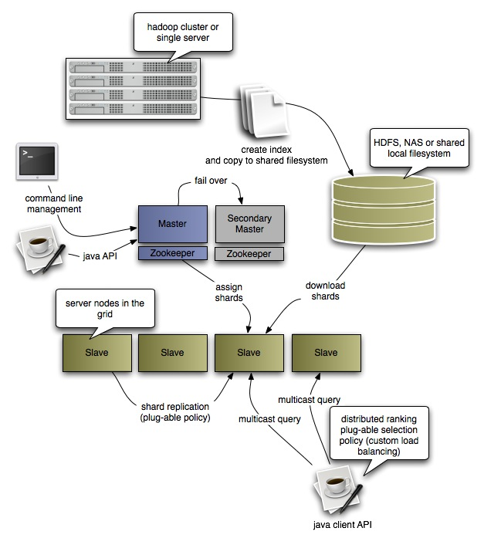
Katta Architecture
(Distributed Lucene)
http://katta.sourceforge.net/

